Slide 1
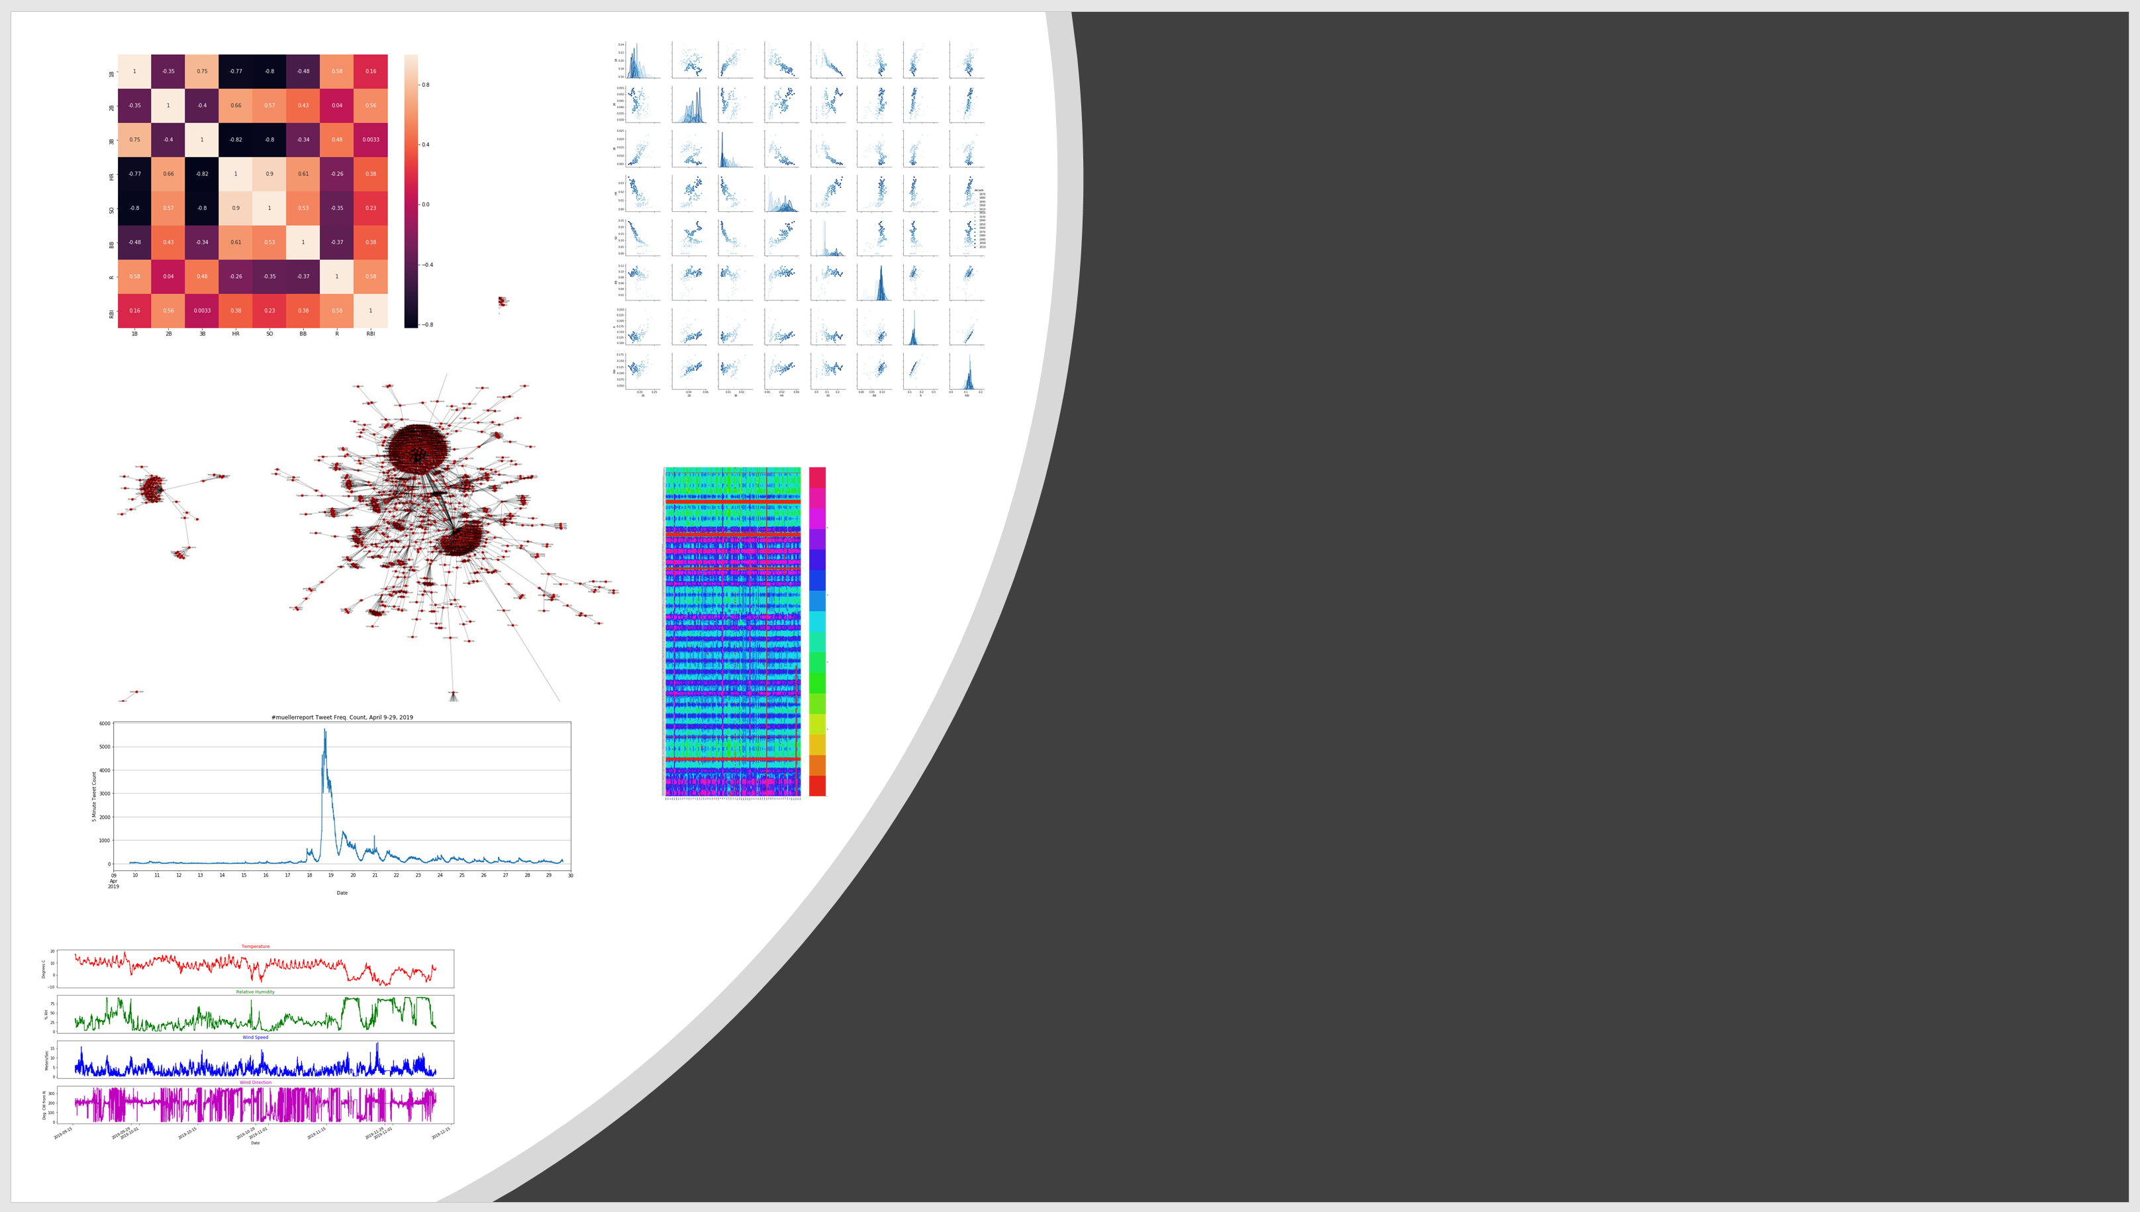
Data Visualization With Python Using Jupyter Notebooks
Jeff Sale
SDSC Learning Design Technologist
XSEDE ECSS Visualization Consultant
XSEDE Workforce Development
https://tinyurl.com/201912-dvp

Slide 2
Code of Conduct
XSEDE has an external code of conduct for XSEDE sponsored events which represents XSEDE's commitment to providing an inclusive and harassment-free environment in all interactions regardless of gender, sexual orientation, disability, physical appearance, race, or religion. The code of conduct extends to all XSEDE-sponsored events, services, and interactions.
Code of Conduct: https://www.xsede.org/codeofconduct
Contact:
Event organizer: Jeff Sale, SDSC Learning Design Technologist, XSEDE ECSS Visualization Consultant
XSEDE ombudspersons:
Linda Akli, Southeastern Universities Research Association (akli@sura.org)
Lizanne Destefano, Georgia Tech (lizanne.destefano@ceismc.gatech.edu)
Ken Hackworth, Pittsburgh Supercomputing Center (hackworth@psc.edu)
Bryan Snead, Texas Advanced Computing Center (jbsnead@tacc.utexas.edu)

Slide 3

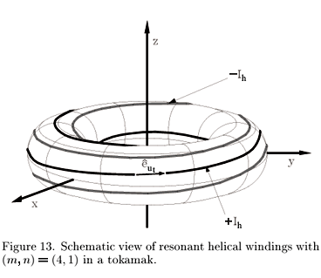


About Me
Born in Canada (Naturalized last year. Woohoo I can vote!!)
B.S., Applied Physics
Emphasis: Condensed Matter (“Solid State Physics”)
San Diego State University
Mesa Community College
M.A. Learning Design and Technology
Specialize in MOOCs
SDSC Learning Design Technologist
XSEDE ECSS and Workforce Development

Slide 4
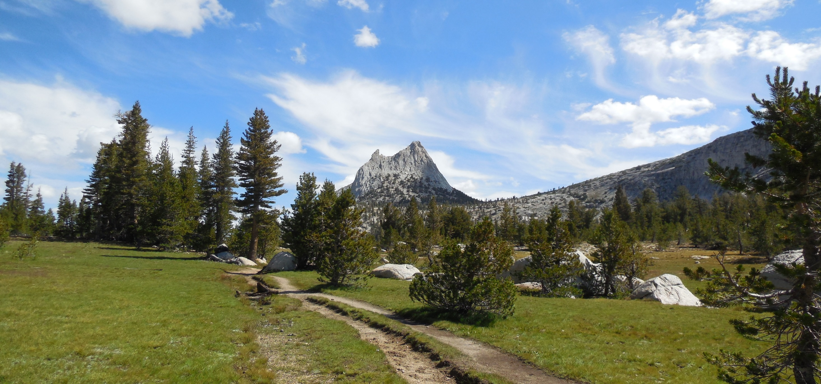
The John Muir Trail

Slide 5

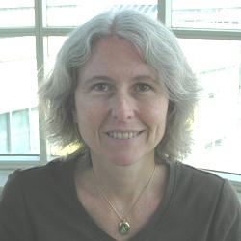
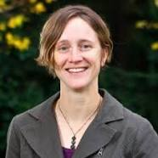
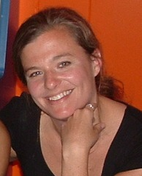
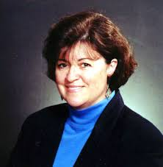
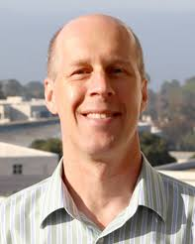
Acknowledgements
XSEDE and SDSC
Chris Myers*, Senior Research Associate, Center for Advanced Computing, Adjunct Professor, Dept. of Physics, Cornell University
Susan Mehringer*, Associate Director, Consulting, Cornell University Center for Advanced Computing, & XSEDE L3 for Training, WBS 2.1.2
Kate Starbird, Associate Professor, Human Centered Design & Eng., U. of Washington
Jen Zeimke, Associate Professor, Political Science, John Carroll Univ.
Mary Thomas and Bob Sinkovits, SDSC User Training
*Data Science With Python Tutorial
Cornell Virtual Workshop, https://cvw.cac.cornell.edu/

Slide 6
NEW!! Python for Data Science – Part 1 XSEDE Tutorial
Cornell Virtual Workshop
https://cvw.cac.cornell.edu/PyDataSci1/

Slide 7

The Jupyter Project
“Project Jupyter exists to develop open-source software, open-standards, and services for interactive computing across dozens of programming languages.”
https://jupyter.org/

Slide 8


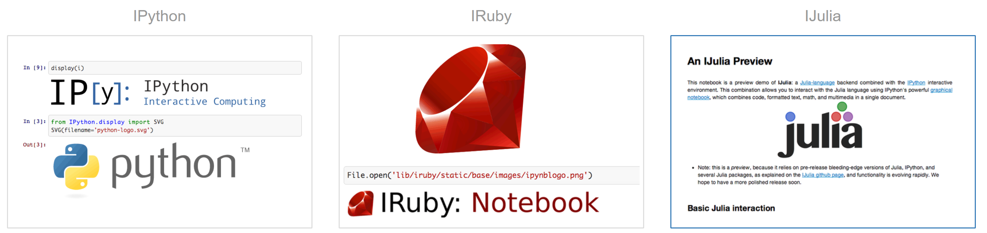
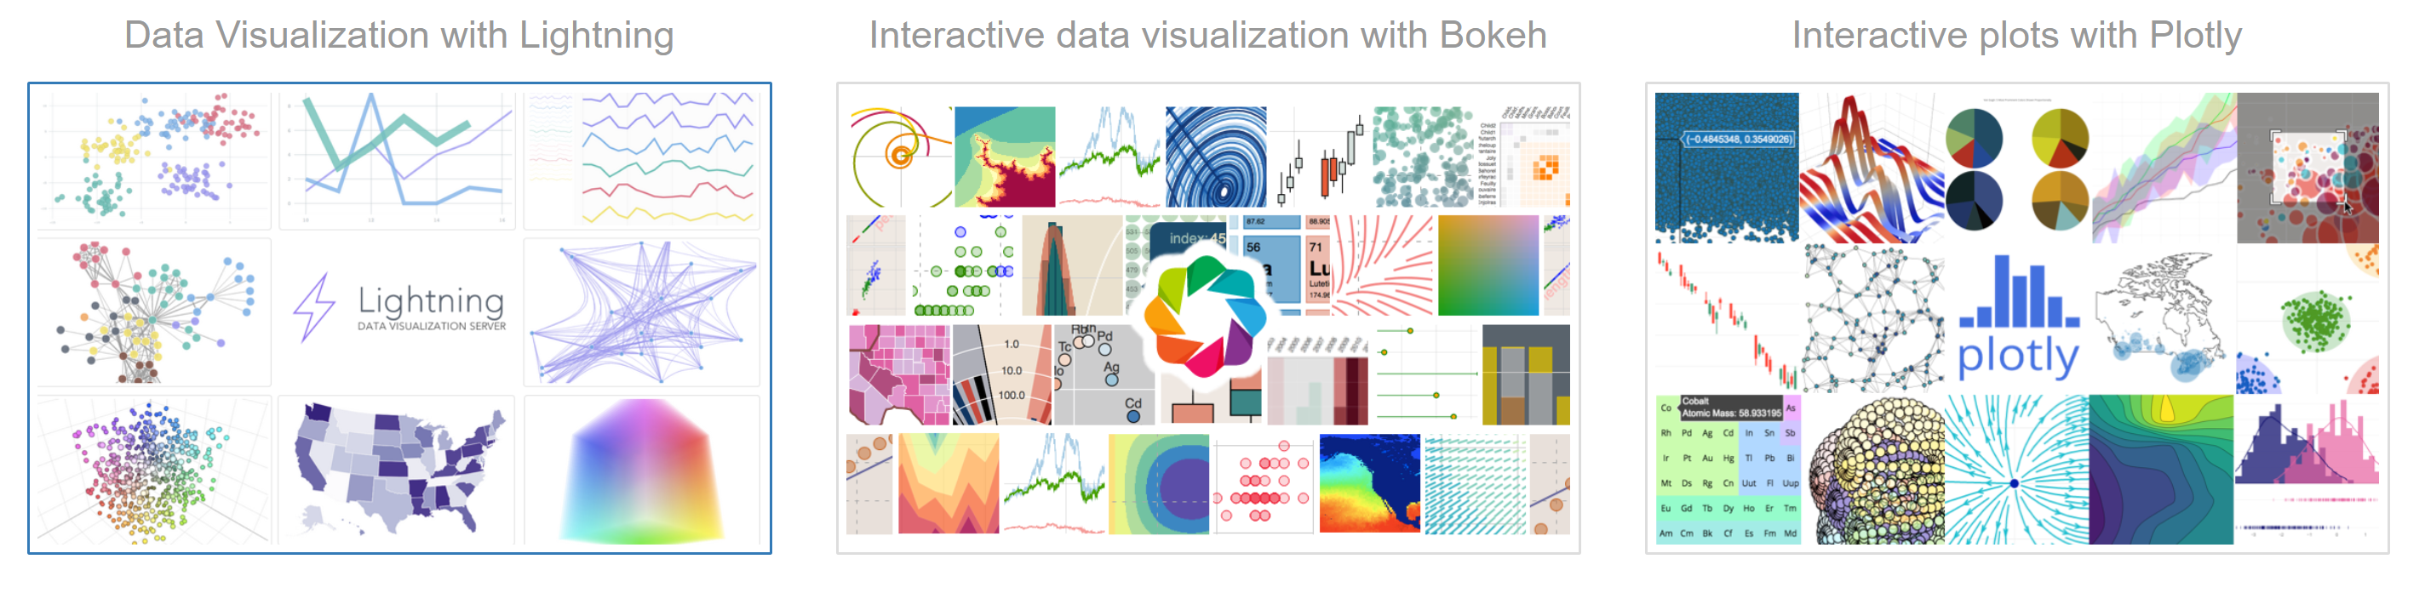
The Jupyter Menagerie

Slide 9
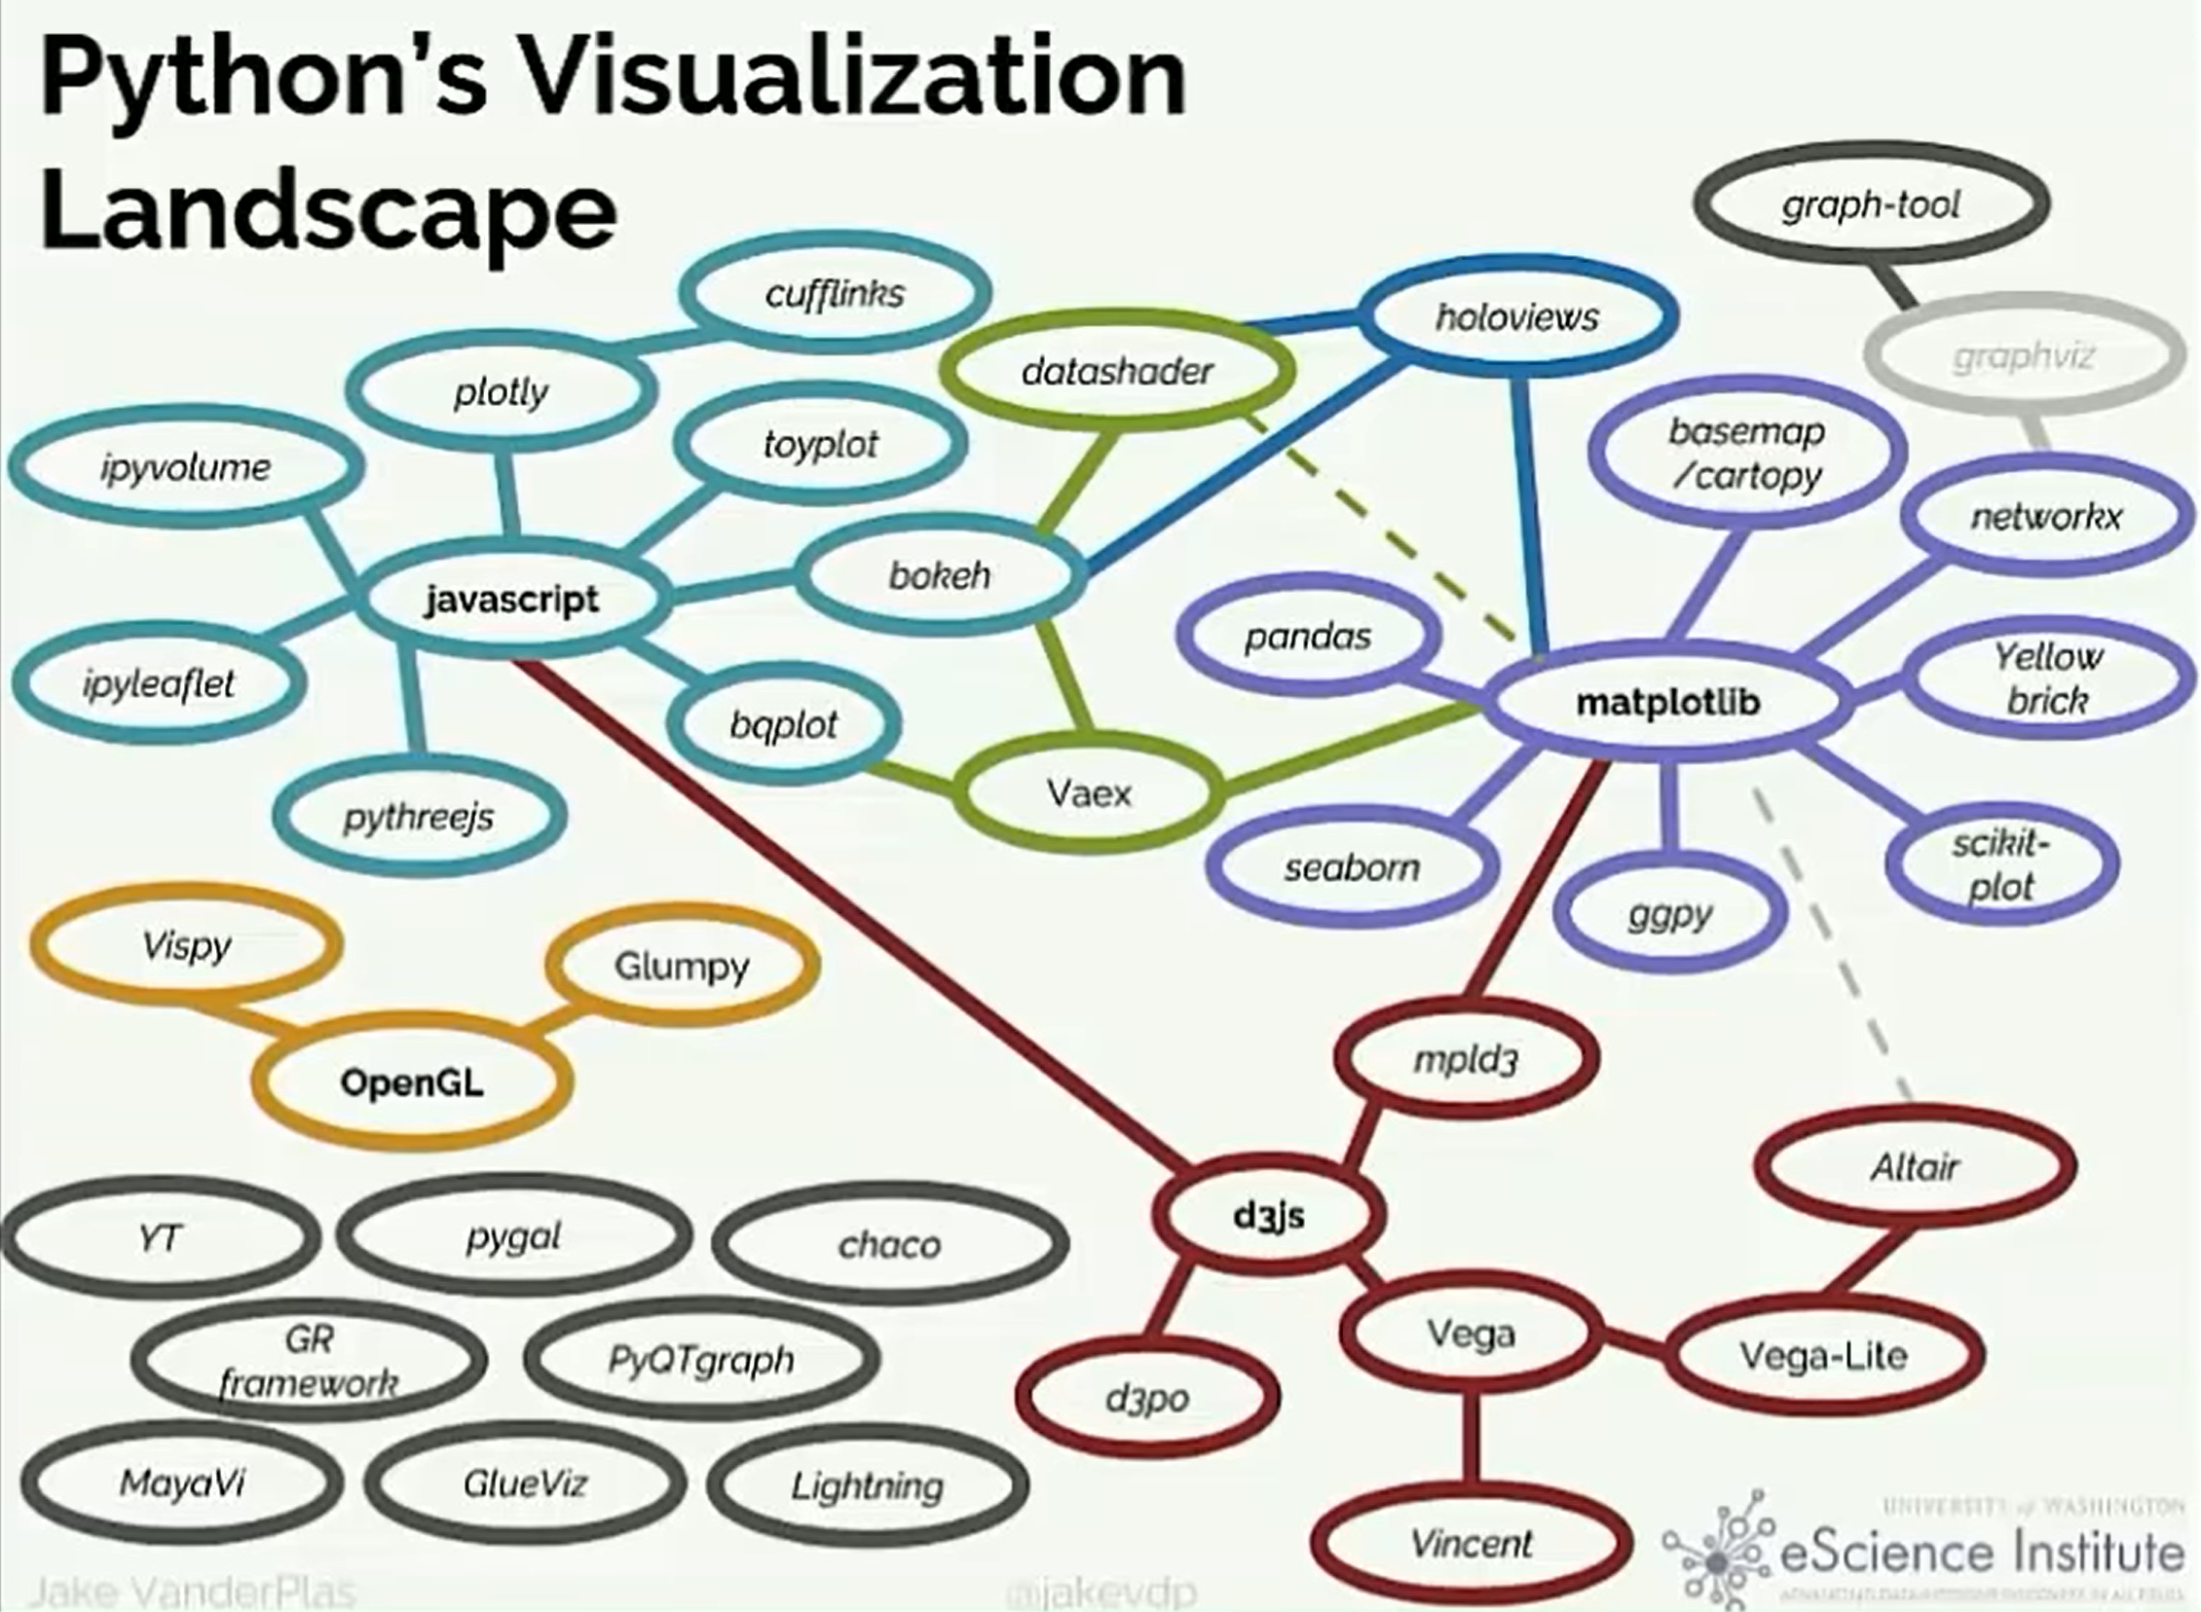
Courtesy: Jake VanderPlas The Python Visualization Landscape PyCon 2017, https://www.youtube.com/watch?time_continue=134&v=eVET9IYgbao&feature=emb_logo

Slide 10
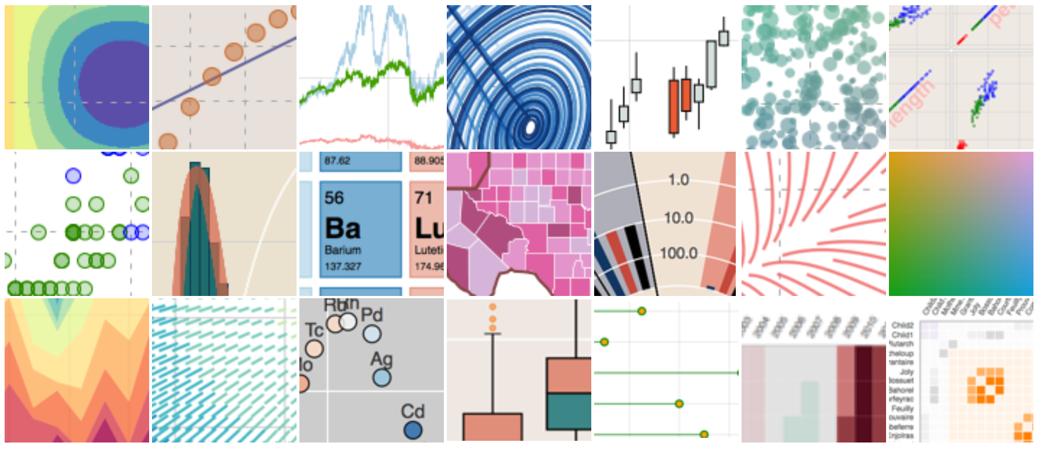
Bokeh
“Bokeh is an interactive visualization library for modern web browsers. It serves as a web-based front end to matplotlib using JavaScript behind the scenes to run in a browser”.
https://docs.bokeh.org/en/latest/index.html
Notes:
It provides elegant, concise construction of versatile graphics, and affords high-performance interactivity over large or streaming datasets. Bokeh can help anyone who would like to quickly and easily make interactive plots, dashboards, and data applications.

Slide 11

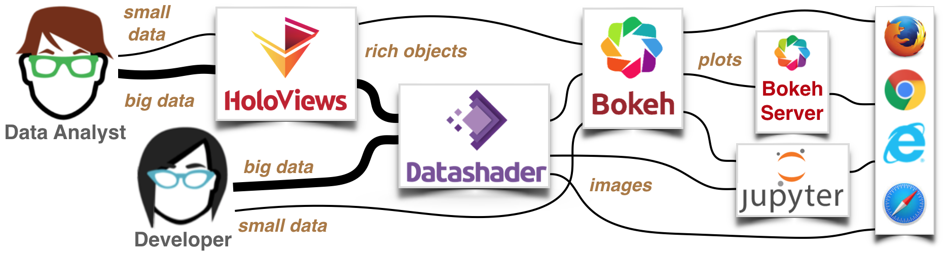
HoloViz

Slide 12
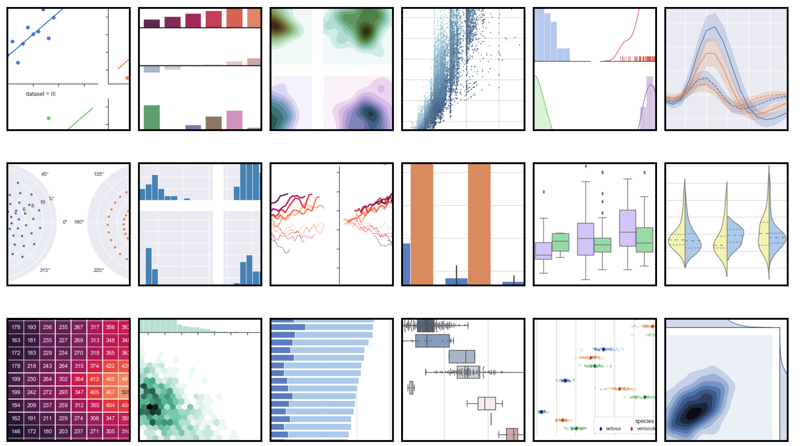
Seaborn
Seaborn is a Python data visualization library based on matplotlib. It provides a high-level interface for drawing attractive and informative statistical graphics.
https://seaborn.pydata.org/

Slide 13
Ways to Access Jupyter on XSEDE Systems
TACC Visualization Portal
https://vis.tacc.utexas.edu/
SDSC Comet
https://education.sdsc.edu/training/interactive/dpc_python_2019/
PSC Bridges
https://www.psc.edu/user-resources/software/jupyter

Slide 14
Warning About My Programming Expertise
Stack Overflow Programmer
“See One, Do One, Teach One”
(Teaching Hospital Surgery Mantra)

Slide 15

Let’s just jump into it!

